Slide 1
Primary Care Access Recovery Plan & Pharmacy First
London Region Briefing 22 November 2023
Tony Carson, London Regional Senior Pharmacy Integration Lead
Notes:
Standard title slide

Slide 2
Agenda
Record & Introduction
Background
Launch Dates
Contraception & Blood Pressure Services
Pharmacy First
Digital deliveries
Funding
National next steps & communications
Implementation
Discussion, next steps in London
Q&As
CAVEAT – this event is an overview to support discussions on implementation rather than covering operational elements & funding. Lots available on websites (see links) and more detail to come.

Slide 3

Delivery Plan for Recovering Access to Primary Care
On 9th May 2023, NHSE and DHSC published the Delivery Plan for recovering access to primary care.
The plan includes a commitment to:
  Commission community pharmacies to deliver a Pharmacy First service by enabling the supply of NHS medicines for seven conditions and
  Increase provision of the community pharmacy NHS Pharmacy Contraception Service and the Blood Pressure Checks Service.
  Invest to significantly improve the digital infrastructure between general practice and community pharmacy.

Slide 4
Service Launch Dates
After successful negotiations between Community Pharmacy England, NHSE and DHSC, we have agreed to:
Launch expansion of Pharmacy Contraception Service on
1 December 2023
Relaunch Blood Pressure Check Service on
1 December 2023
Launch Pharmacy First on 31 January 2024, subject to the appropriate digital systems being in place to support these services

Slide 5
Expansion of Contraception Service
Introduction of initiation of contraception in community pharmacies, supporting women to have easier access to contraception, through:
Additional funding
Greater use of pharmacy team skill mix
Encouraging contractors to sign up
Both ongoing supply and initiation of supply will be combined into one service.
NHS website postcode search tool enable patients to find local pharmacies who deliver the contraception service.
£75 million per year additional funding, outside of the global sum, has been made available to support the expansion of both these services.

Slide 6
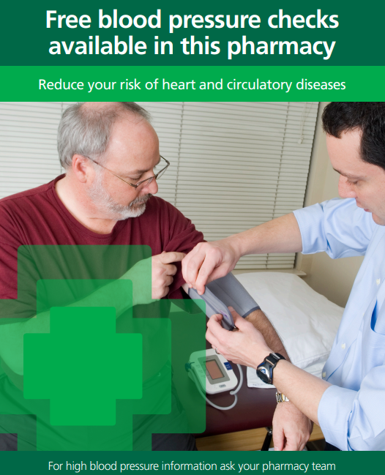
Relaunch of Blood Pressure Service
Blood pressure checks to help identify the 5.5 million people with undiagnosed blood pressure at risk of heart attack and stroke, through:
Additional funding
Greater use of pharmacy team skill mix
Encouraging contractors not signed up to do so
Encouraging contractors who have signed up to see more patients and completion of more ABPMs
£75 million per year additional funding, outside of the global sum, has been made available to support the expansion of both these services.

Slide 7
Pharmacy First
Pharmacy First will be a new advanced service that will include 7 new clinical pathways and will replace the Community Pharmacist Consultation Service (CPCS).
This means the full service will consist of three elements:
Pharmacy First (clinical pathways)
Pharmacy First (urgent repeat medicine supply)
Pharmacy First (NHS referrals for minor illness)
new element
previously commissioned as the CPCS
previously commissioned as the CPCS
Contractors will need to be able to provide all 3 elements (only exception is DSPs will not need to do otitis media pathway due to need to use otoscopes).
Remote consultations for 6 of the 7 clinical pathways are permissible via high quality video and if clinically appropriate speed of access to medicines can be facilitated.

Slide 8
Infections to be managed via Clinical Pathways
Clinical Pathway | Age range
Uncomplicated UTI Shingles Impetigo Infected Insect Bites Sinusitis Sore Throat Acute Otitis Media | Women 16-64 years 18 years and over 1 year and over 1 year and over 12 years and over 5 years and over 1 to 17 years

Slide 9
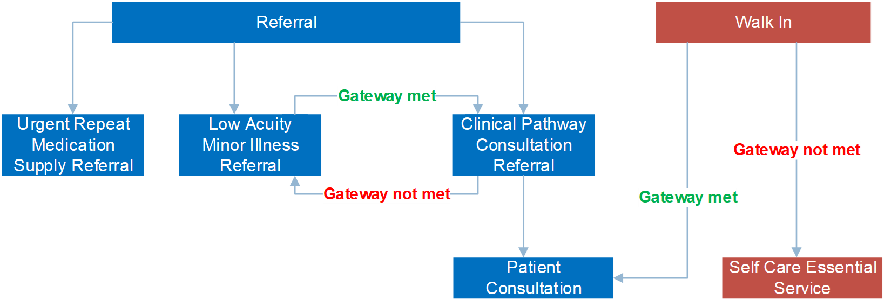
Pharmacy First Service Overview
The existing referral routes for the CPCS will apply to the new clinical pathway's element, but patients will also be able to self-refer to a pharmacy for the clinical pathways (subject to the patient passing a clinically established gateway point in the relevant clinical pathway).

Slide 10
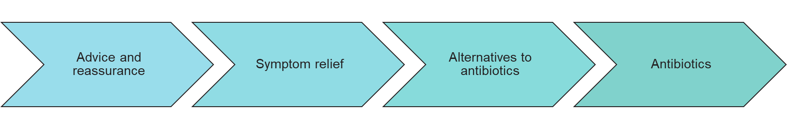
Development of Clinical Pathways
Multi-professional expert working group to develop robust clinical pathways for each of the 7 conditions
Clinical pathway approach
Adherence to NICE guidelines
National template for Patient Group Directions developed by SPS
AMR Programme Board Oversight
  National Medical Director and Chief Medical Officer for England

Slide 11
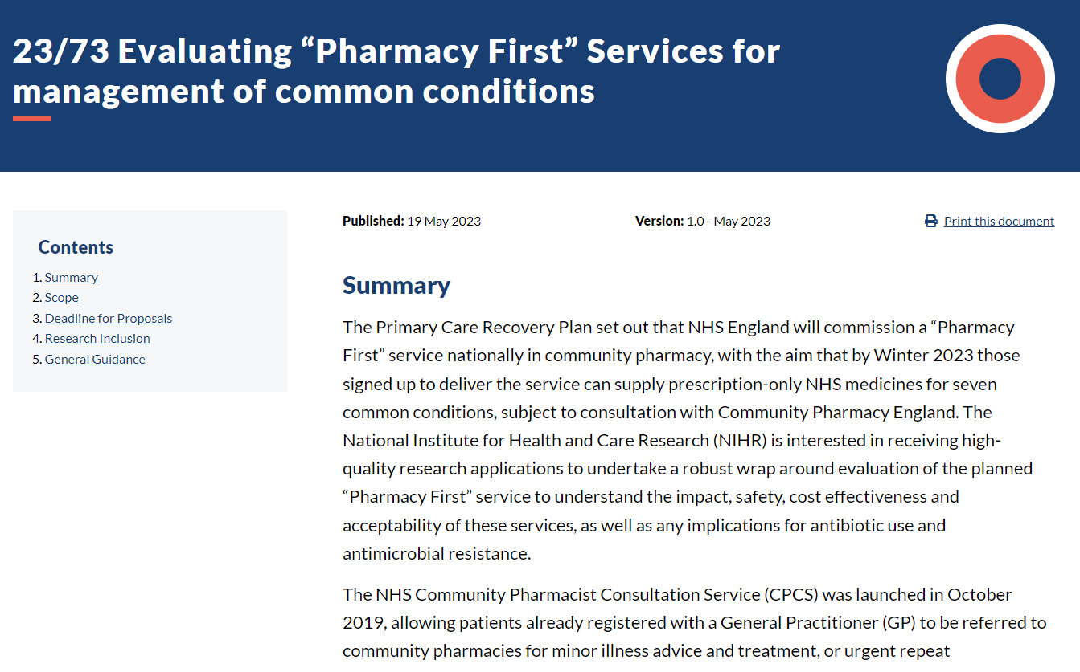
Surveillance

Slide 12
Summary of digital deliverables
Update DOS, Profile Manager, nhs.uk and 111 online to support channel shifting of patients to pharmacy
Digital referrals from GP to pharmacy
Capability to access patient’s GP record
Develop and onboard suppliers to the Digital Service for Integrated Care to ensure solutions are assured and meet user requirements and NHS standards
Develop a Payment & Data API to support reimbursement and service monitoring
Capability to update the patient’s GP record following a pharmacy consultation

Slide 13








Digital Overview
Pharmacies
GP practices
IT system suppliers
9
Live Clinical Services
CPCS +7 clinical pathways
10,500
6,500
5 suppliers
6 products
17,000 sites
Blood Pressure Check Service
Contraception Management Service
Safe
Secure
Resilient
Compliant
Consultations: Shingles, Impetigo, Sinusitis, Otitis Media, Infected Bites, Sore Throat and uncomplicated Urinary Tract Infections
Blood Pressure Check Service and
Contraception Management Service
Shift 7.7 million GP appointments to community pharmacies, where pharmacists safely supply antibiotics and antivirals
Increase blood pressure checks from c1.4m to 2.5m every year
0.5m women can get oral contraception from pharmacies
Digital Service Requirements
Support Requirements
Access Record
Access medical history in GP patient record to support the consultation
Consultation Template
Capture details of the consultation (e.g. notes, outcomes, meds issued)
Update Record
Send post consultation reports back to GP systems to update the record
Payment & Data API
Dataflows to enable renumeration and national reporting on meds
Staff Training
Handbooks/ SOPs
Helpdesk
Staff & Patient Comms

Slide 14
Funding
The fee structure for Pharmacy First will be as follows:
An initial fixed payment of £2,000 that can be claimed from December 2023 up until service launch. This fee will be recovered from contractors who have not delivered 5 clinical pathways consultations passing the gateway point within the relevant pathway by 31 March 2024.
A £15 item of service fee for each Pharmacy First consultation. This includes any clinical pathways consultation and any consultations which would previously have been delivered under the CPCS advanced service (i.e. consultations delivered from 1 January 2024 will attract the £15 fee).
A monthly fixed payment of £1,000 from February 2024 for pharmacy contractors delivering Pharmacy First who reach a minimum number of monthly clinical pathway consultations.

Slide 15
Next Steps
Publication of:
Details of the registration and set-up fee process
Service specification
7 clinical pathways
23 Patient Group Directions and 1 Supply Protocol
Note post call – Updated Service Specification & PGDs for Contraception Service published at https://www.england.nhs.uk/publication/nhs-pharmacy-contraception-service/ and Updated Service Specification for the Blood Pressure Check service published at https://www.england.nhs.uk/primary-care/pharmacy/nhs-community-pharmacy-bp-checks-and-hypertension-case-finding-advanced-service/

Slide 16
National Communications
NHS Announcement - NHS England » Pharmacy reforms to bring new services to the high street
Letter to Pharmacy Contractors - Pharmacy First letter to contractors - GOV.UK (www.gov.uk)
Briefing on Primary Care Bulletin on16 November
Community Pharmacy England - more details for pharmacy contractors at Pharmacy First service - Community Pharmacy England (cpe.org.uk)
CPE webinars for pharmacy contractors 27 & 28 November
Joint NHSE/CPE webinars on PF, BP & OC in December & January (total of 5)
GP Webinar 7 December General Practice Webinar | NHS England Events
ICB Pharmacy Contract Managers & CPCLs monthly meeting – 23 Nov 11-12:30
Service finders for Contraception & BP service Find a pharmacy that offers free blood pressure checks - NHS (www.nhs.uk)

Slide 17
Implementation

Slide 18
Part of PCARP
Is part of PCARP and therefore implementation of Pharmacy First and expanded BP & Contraception level should be embedded within PCARP plans.
To be delivered at a system level.
Not just community pharmacy – includes range of stakeholders, including
  ICB Heads of Primary Care, Primary Care & PCARP teams
  ICB Chief Pharmacists, CPCLs & Meds Op teams
  ICB Pharmacy Commissioning team
  ICB Digital Leads
  ICB IUC teams
  LPCs & LMCs
  Public Health teams
  111 Providers
  ICB Communications Teams
  Regional teams, including Digital First, Pharmacy & Meds Op, Primary Care, DoS, IUC, Work, Training & Education (former HEE)

Slide 19
Challenges
Community Pharmacy
Referrers
Others
Very tight timeframes
Pharmacy workforce already stretched
Winter pressures
Difficulties in recruitment
Locum staff
Overall funding pressures – closures of pharmacies
New IT
GP, 111, U&EC
Very tight timeframes
Variable referral rates into CPCS
Understanding of & Confidence in services
Winter pressures
Overall funding pressures
New IT
Digital
National Testing & Delivery
Implementation
Training
Communications
Public – understanding, expectations & experience

Slide 20






Mitigations – London Community Pharmacies do deliver
1775 community pharmacies providing NHS services (approx. 1600 CPCS)
149 million prescription items dispensed in 2022/23 (5.7% increase)
215 000 Blood Pressure Checks in 2022/23
220 000 Community Pharmacist Consultation Service consultations in 2022/23
Since Jan 2021 almost 6 million COVID vaccinations
570 000 Flu vaccinations in 2022/23
New funding – total £645m over 2023/24 & 2024/25
Notes:
Each CPCS consultation has come from a referral from 111 or a GP practice and most of those referrals would likely to have ended up in an appointment at a GP practice or Out of Hours service instead of a referral to CPCS

Slide 21
Mitigations
Digital
Training
Others
Funding provided to GP & Pharmacy IT systems
Multiple teams supporting developments
Commitment to end-to-end integration
Robust testing – PF launch dependent on successful testing
Range of support
Communications to all staff
Clinical Examination Skills training – online & face-to-face*
4 face-face ENT workshops (240 places) – CPPE & LPCs
CPPE Developing role of pharmacy technicians**
CPPE ready to support workforce when more details available
Digital training & support from IT providers
Existing PCARP & Urgent Care Access workstreams at ICB& Region
London Pharmacy Digital Integration workstreams
ICB teams, including CPCLs
National resources, including communications & service finders
Support of LPCs and other pharmacy bodies
Regional teams
Public Health teams
Community Pharmacists | CliniSkills *
Community pharmacy technician: advancing your role : CPPE **

Slide 22
Discussion
  Next steps
  Future Regional meetings
  Questions
Notes:
Plain slide with subhead and bullets

